Slide 1
GAP ANALYSIS THEME FOR BUSINESS
“Here is where your presentation begins”

Slide 2
CONTENTS OF THIS TEMPLATE
You can delete this slide when you’re done editing the presentation
Fonts | To view this template correctly in PowerPoint, download and install the fonts we used
Used and alternative resources | An assortment of graphic resources that are suitable for use in this presentation
Thanks slide | You must keep it so that proper credits for our design are given
Colors | All the colors used in this presentation
Icons and infographic resources | These can be used in the template, and their size and color can be edited
Editable presentation theme | You can edit the master slides easily. For more info, click here
For more info:
SLIDESGO | OUR BLOG | FAQs
You can visit our sister projects:
FREEPIK | FLATICON | STORYSET | WEPIK | VIDEVO

Slide 3
WHOA!
This can be the part of the presentation where you can introduce yourself, write your email...

Slide 4
TABLE OF CONTENTS
01
02
INTRODUCTION
IMPROVEMENT
03
04
UNDERSTANDING
ACTION PLAN
You can describe the topic of the section here
You can describe the topic of the section here
You can describe the topic of the section here
You can describe the topic of the section here

Slide 5
01
INTRODUCTION
Insert a subtitle here in case you need it

Slide 6
INTRODUCTION
You can give a brief description of the topic you want to talk about here. For example, if you want to talk about Mercury, you can say that it’s the smallest planet in the entire Solar System

Slide 7
WHAT IS EXACTLY IS THE GAP?
Mercury is the closest planet to the Sun and the smallest one in the entire Solar System. This planet's name has nothing to do with the liquid metal, since Mercury was named after the Roman messenger god. Despite being closer to the Sun than Venus, its temperatures aren't as terribly hot as that planet's. Its surface is quite similar to that of Earth's Moon, which means there are a lot of craters and plains
Speaking of craters, many of them were named after artists or authors who made significant contributions to their respective fields. Mercury takes a little more than 58 days to complete its rotation, so try to imagine how long days must be there! Since the temperatures are so extreme, albeit not as extreme as in Venus, and the solar radiation is so high, it has been deemed to be non-habitable for humans

Slide 8
WHAT IS A GAP ANALYSIS?
Do you know what helps you make your point clear? Lists like this one:
They’re simple
Organize your ideas clearly
You’ll never forget to buy milk!
And the most important thing: the audience won’t miss the point of your presentation

Slide 9
WHAT ARE THE CONSEQUENCES OF THE GAP?
COMPANY MISSION 01
Mercury is the closest planet to the Sun and the smallest one in the Solar System—it’s only a bit larger than the Moon
COMPANY MISSION 02
Venus has a beautiful name and is the second planet from the Sun. It’s terribly hot even hotter than Mercury

Slide 10
02
IMPROVEMENT
Insert a subtitle here in case you need it

Slide 11
BASIC PROCESS FOR GAP ANALYSIS
GAP ANALYSIS
CURRENT STATE
DESIRED STATE
Mercury is the closest planet to the Sun and the smallest one in the Solar System
Venus has a beautiful name and is the second planet from the Sun in the System
Saturn is a gas giant and is composed mostly of hydrogen and helium

Slide 12
GAP ANALYSIS COMPANY GOALS
GOAL 1
GOAL 2
GOAL 3
GOAL 4
Venus is the second planet from the Sun
Despite being red, Mars is a cold place
Jupiter is the biggest planet of them all
Saturn is composed of hydrogen and helium

Slide 13
GAP ANALYSIS: THE PHASES
ACTUALITY
MARKET
GROWTH
PRODUCT
DIVERSIFICATION
POTENTIAL
Venus is the second planet from the Sun
Mercury is the closest planet to the Sun
Despite being red, Mars is actually a cold place
Jupiter is the biggest planet of them all
Saturn is composed of hydrogen and helium
Neptune is the farthest planet from the Sun

Slide 14
—SOMEONE FAMOUS
“This is a quote, words full of wisdom that someone important said and can make the reader get inspired”.

Slide 15
AWESOME WORDS

Slide 16

A PICTURE IS WORTH A THOUSAND WORDS

Slide 17

TO REINFORCE THE CONCEPT, TRY USING AN IMAGE
Images reveal large amounts of data, so remember: use an image instead of a long text. Your audience will appreciate it

Slide 18
4,498,300
Big numbers catch your audience’s attention

Slide 19
3,100,000
5.3B
70K
Mercury is a small planet
Venus has very high temperatures
Jupiter is the biggest planet

Slide 20
KEY AREAS THAT REQUIRE IMPROVEMENT
80%
75%
93%
SALES
EMPLOYEE
CUSTOMER
Mercury is the closest planet to the Sun
Venus is the second planet from the Sun
Despite being red, Mars is a very cold planet

Slide 21
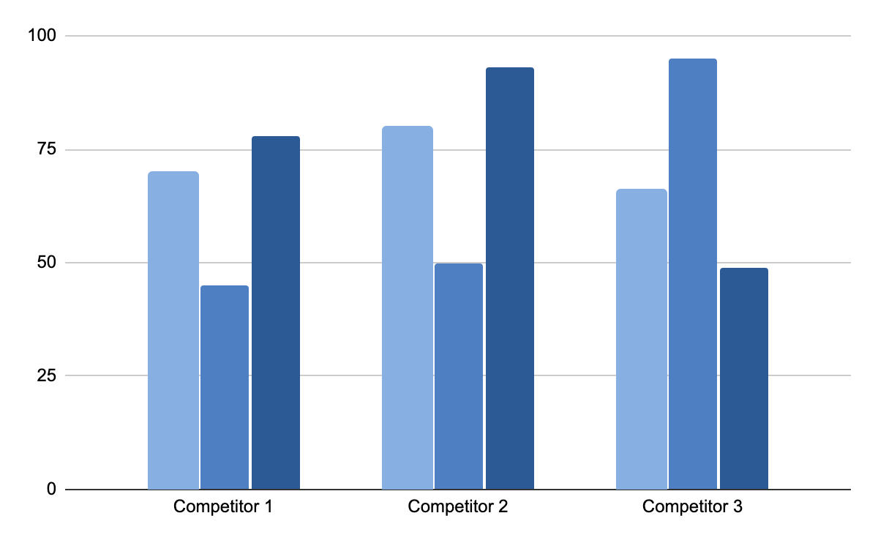
FINANCIAL COMPARISON
REVENUE
Despite being red, Mars is a cold planet
PROFITS
Venus has a beautiful name and high temperatures
CASH BALANCE
Mercury is the closest planet to the Sun
Follow the link in the graph to modify its data and then paste the new one here. For more info, click here

Slide 22
GAP ANALYSIS PROCEDURE
Q GOAL
Q GOAL
Earth is where we all live
Mars is actually a very cold place
1st
2nd
3rd
4th
5th
Q GOAL
Q GOAL
Q GOAL
Neptune is far from the Sun
Venus has a beautiful name
Jupiter is the biggest planet of them all

Slide 23
YOUR MAP
MARS
Mar is a very
cold planet
VENUS
Venus has a beautiful name

Slide 24
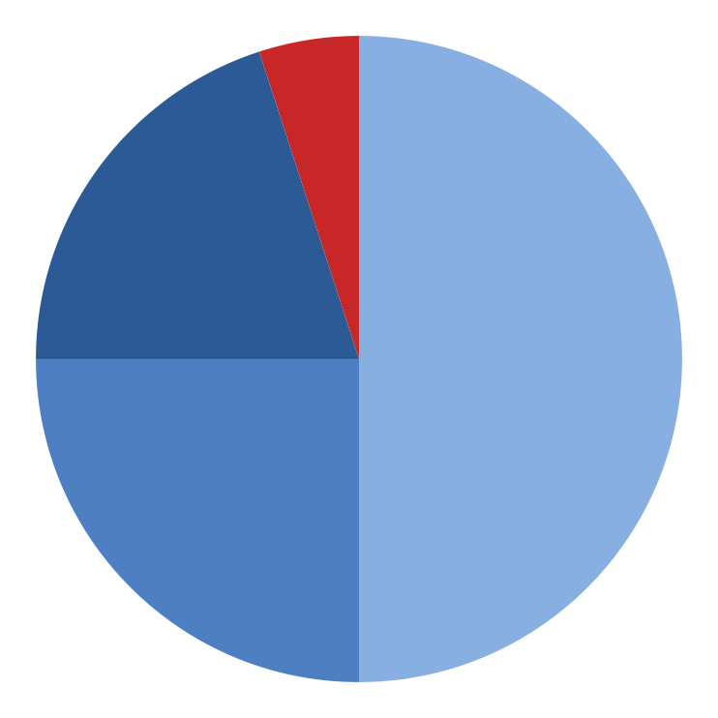
OUR MARKET SHARE
5%
50%
COMPETITOR 4
COMPETITOR 1
Mercury is the closest planet from the Sun
Despite being red, Mars is a very cold planet
20%
25%
COMPETITOR 3
COMPETITOR 2
Venus is the second planet from the Sun
Saturn is composed of hydrogen and helium
Follow the link in the graph to modify its data and then paste the new one here. For more info, click here

Slide 25

DESKTOP SOFTWARE
You can replace the image on the screen with your own work. Just right-click on it and select “Replace image”

Slide 26
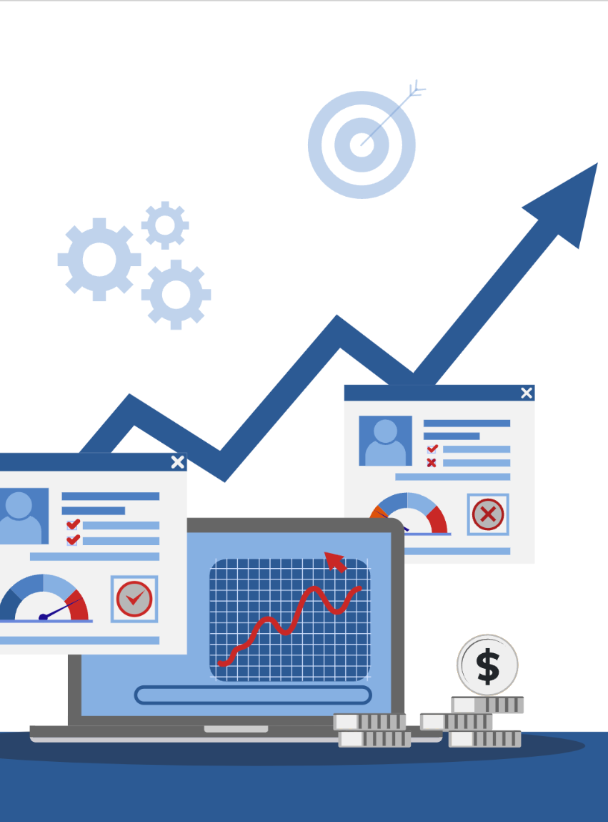
TABLET APP
You can replace the image on the screen with your own work. Just right-click on it and select “Replace image”

Slide 27
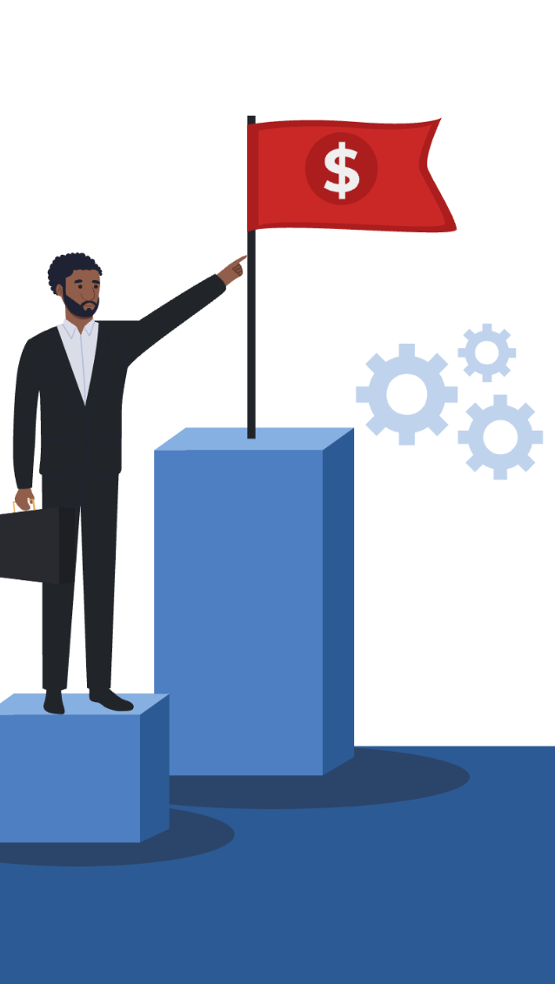
MOBILE WEB
You can replace the image on the screen with your own work. Just right-click on it and select “Replace image”

Slide 28



OUR TEAM
JIMMY TIMMY
SUE DOE
JOHN SMITH
You can speak a bit about this person here
You can speak a bit about this person here
You can speak a bit about this person here

Slide 29
HOW DO WE DO THAT?
STEP 1 - PLAN
STEP 2- ACT
Mercury is the closest planet from the Sun
Mars is actually a very cold place in the System
STEP 3 - DO
STEP 4 - CHECK
Venus is the second planet from the Sun
Saturn is composed of hydrogen and helium

Slide 30
GAP ANALYSIS TOOL - SERVQUAL
ASSURANCE
Mercury is the closest planet to the Sun and the smallest of them all
EMPATHY
Despite being red, Mars is a very cold planet full of iron oxide
TANGIBLE
Jupiter is a gas giant and the biggest planet of them all
RELIABILITY
Saturn is the second-largest planet in the Solar System
RESPONSIVENESS
Neptune is the fourth-largest planet in the Solar System

Slide 31
6 STEPS FLOWCHART
STEP 1
STEP 2
STEP 3
STEP 4
STEP 5
STEP 6
Saturn has around eighty moons, more than Jupiter
Neptune is the farthest planet from the Sun
Venus is the second planet from the Sun and it’s hot
Mercury is the smallest planet in the Solar System
Mars is a cold place and it's full of iron oxide dust
Earth is the only planet known to harbor life
PLAN
DO
CHECK
ACT

Slide 32
GAP ANALYSIS - STATES
 | CURRENT | TARGET | ACTION | PRIORITY | OWNER | DUE DATE
BUSINESS | Insert your own text | Insert your own text | Insert your own text | Insert your own text | Insert your own text | Insert your own text
USERS | Insert your own text | Insert your own text | Insert your own text | Insert your own text | Insert your own text | Insert your own text
TOOLS | Insert your own text | Insert your own text | Insert your own text | Insert your own text | Insert your own text | Insert your own text
TEAM | Insert your own text | Insert your own text | Insert your own text | Insert your own text | Insert your own text | Insert your own text

Slide 33
GAP ANALYSIS - QUESTIONS
 | CURRENT STATE | FUTURE STATE | GAP | ACTIONS
WHAT | Insert your own text | Insert your own text | Insert your own text | Insert your own text
WHERE | Insert your own text | Insert your own text | Insert your own text | Insert your own text
WHEN | Insert your own text | Insert your own text | Insert your own text | Insert your own text
WHO | Insert your own text | Insert your own text | Insert your own text | Insert your own text
HOW | Insert your own text | Insert your own text | Insert your own text | Insert your own text

Slide 34
GAP ANALYSIS TOOL - 7S
STRATEGY |  | Insert your own text here
STRUCTURE |  | Insert your own text here
STYLE |  | Insert your own text here
STAFF |  | Insert your own text here
SKILLS |  | Insert your own text here
SYSTEMS |  | Insert your own text here

Slide 35
GAP ANALYSIS PHASES
PHASE 1
ANALYSIS
Mercury is the closest planet to the Sun
PHASE 2
IMPLEMENTATION
Venus is the second planet from the Sun
PHASE 3
PRE-ASSESSMENT
Jupiter is the biggest planet of them all
PHASE 4
ASSESSMENT
Saturn is composed of hydrogen
COMPLIANT

Slide 36
THANK YOU!
Do you have any questions?
youremail@freepik.com
+91 620 421 838
yourcompany.com
Please keep this slide for attribution

